Slide 1
WELCOME
PROJECT NAME : AI BASED DISCOURSE FOR BANKING INDUSTRY

Slide 2
TEAM DETAILS
TEAM LEADER : KRISHNAKUMAR R
TEAM MEMBER 1 : KRISHNA MOORTHY M
TEAM MEMBER 2 : PRASANNA K
TEAM MEMBER 3 : PRAVEEN KUMAAR B

Slide 3
PROBLEM STATEMENT :
Problem Statement (PS) | I am (Customer) | I’m trying to | But | Because
PS-1 | Student | Open new bank account | Takes longer processing time | Distant from home
PS-2 | IT Person | Pay House Loan | Unable to visit banks physically | Rules and regulations in working hours
PS-3 | Worker | Send money to Parents | Any one of UPI id and smartphone is required | Some people can’t afford smart phone
PS-4 | Old age person | Figure out which bank gives highest rate of interests for their welfare | Reliable banking information is insufficient | They are unable to stay up to date

Slide 4
PROPOSED SOLUTION
S.No. | Parameter | Description
1. | Problem Statement (Problem to be solved) | To create a chatbot for banking to provide personal and enhanced way of interaction for customers to guide them in the financial processes involved.
2. | Idea / Solution description | Using Artificial Intelligence with IBM Watson assistant to mimic human conversation in the proposed model to analyse customer data accurately and improve quality of service.
3. | Novelty / Uniqueness | Accept cash delivery requests from customers within a limit which is practically acceptable and higher than that of ATMs cash withdrawal limit.
4. | Social Impact / Customer Satisfaction | 24/7 uninterrupted chatbot service to all the customers with timely improvements of the proposed model based on customer feedback. Handle complex queries by well- structured human and computer interaction.
5. | Business Model (Revenue Model) | Free, efficient, and advanced chatbot service will grab public attention which will surely have a huge positive impact on revenue generated by the company. Also, it helps organisations to automate complex processes.
6. | Scalability of the Solution | Broad positive impact for users and connect them globally. Performance tests can be performed on a regular basis to ensure gradual increase in efficiency of the system without hampering the existing workflow.

Slide 5
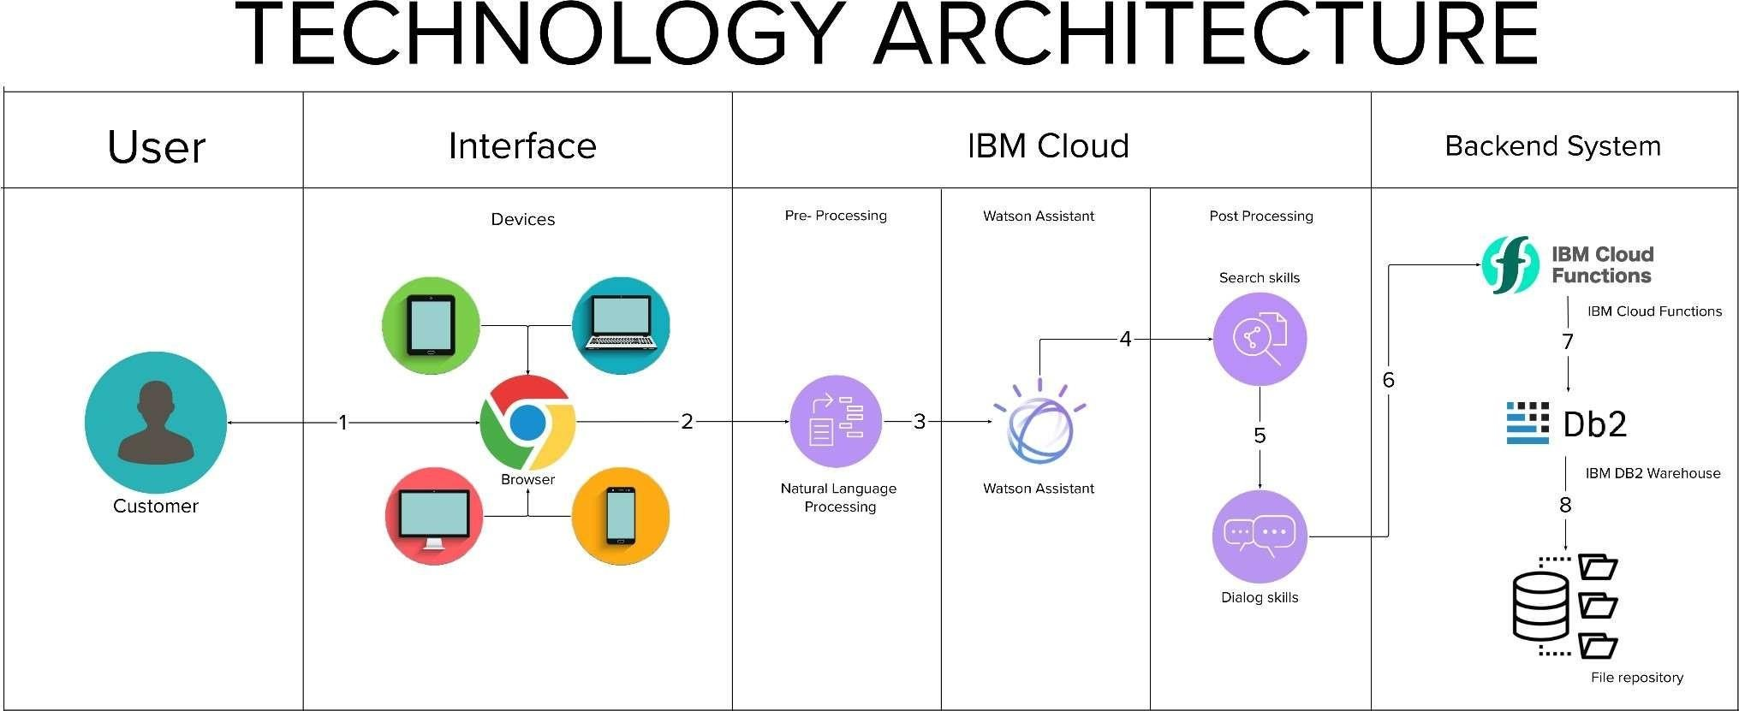
TECHNICAL ARCHITECTURE
Technical Architecture:

Slide 6
S.No | Component | Description | Technology
1. | User Interface | A user interacts with the application.e.g. Web UI, Chatbot etc. | HTML, CSS, JavaScript / Angular Js / React Js etc.
2. | Application Logic-1 | User message processing | NLP and NLU
3. | Application Logic-2 | Matching intent / Entities | IBM Watson Assistant
4. | Application Logic-3 | Training and Building Deep Learning Model | IBM Watson Studio
 | Application Logic-4 | Deployment | Python Flask
5. | Database | Data Type –Dialog, Intent etc. The user's message statistics and trained model data are saved and configured. | MySQL, NoSQL, etc.
6. | Cloud Database | Database Service on Cloud | IBM DB2, IBM Cloudant etc.
7. | File Storage | To store datasets | IBM Block Storage or Other Storage Service or Local Filesystem
8. | External API-1 | To incorporate conversation, language and advanced text analytics into chatbot | IBM Watson Assistant API, etc.
9. | External API-2 | Banking API –Data transfer between two systems and data accessibility. | Banking API, etc.
10. | Machine Learning Model | Models of deep learning for intent detection and other tasks | Object Recognition Model, etc.
11. | Infrastructure (Server / Cloud) | Application Deployment on Local System / Cloud Local Server Configuration: Python Flask Cloud Server Configuration : Cloud Foundry | Python Flask, Cloud Foundry, Kubernetes, etc.

Slide 7
S.No | Characteristics | Description | Technology
1. | Open-Source Frameworks | Open-source frameworks used is Python Flask | Technology used Python Flask
2. | Security Implementations | End-to-end encryption of data, Isolation of customer data, Vulnerability scanning and intrusion detection, Antivirus and anti-malware protection, Security for user devices, Application of security patches. | SHA-256, Encryptions, IAM Controls, OWASP,IBM Watson Assistant etc.
3. | Scalable Architecture | Chatbot architecture consists of four pillars. They are intents, entities ,data flow, scripts (3 – tier architecture –presentation tier, application tier, data tier and Microservices architecture) | Technology used –IBM Watson Assistant
4. | Availability | The Bot is made available using load balancers, distributed servers etc. | Technology used –IBM Watson Assistant
5. | Performance | IBM Watson –automate processes, The deep learning model is trained using IBM Watson studio for better performance | Technology used –IBM Watson Assistant

Slide 8
WEBSITE LINK
http://chatbotibm.pythonanywhere.com/

Slide 9
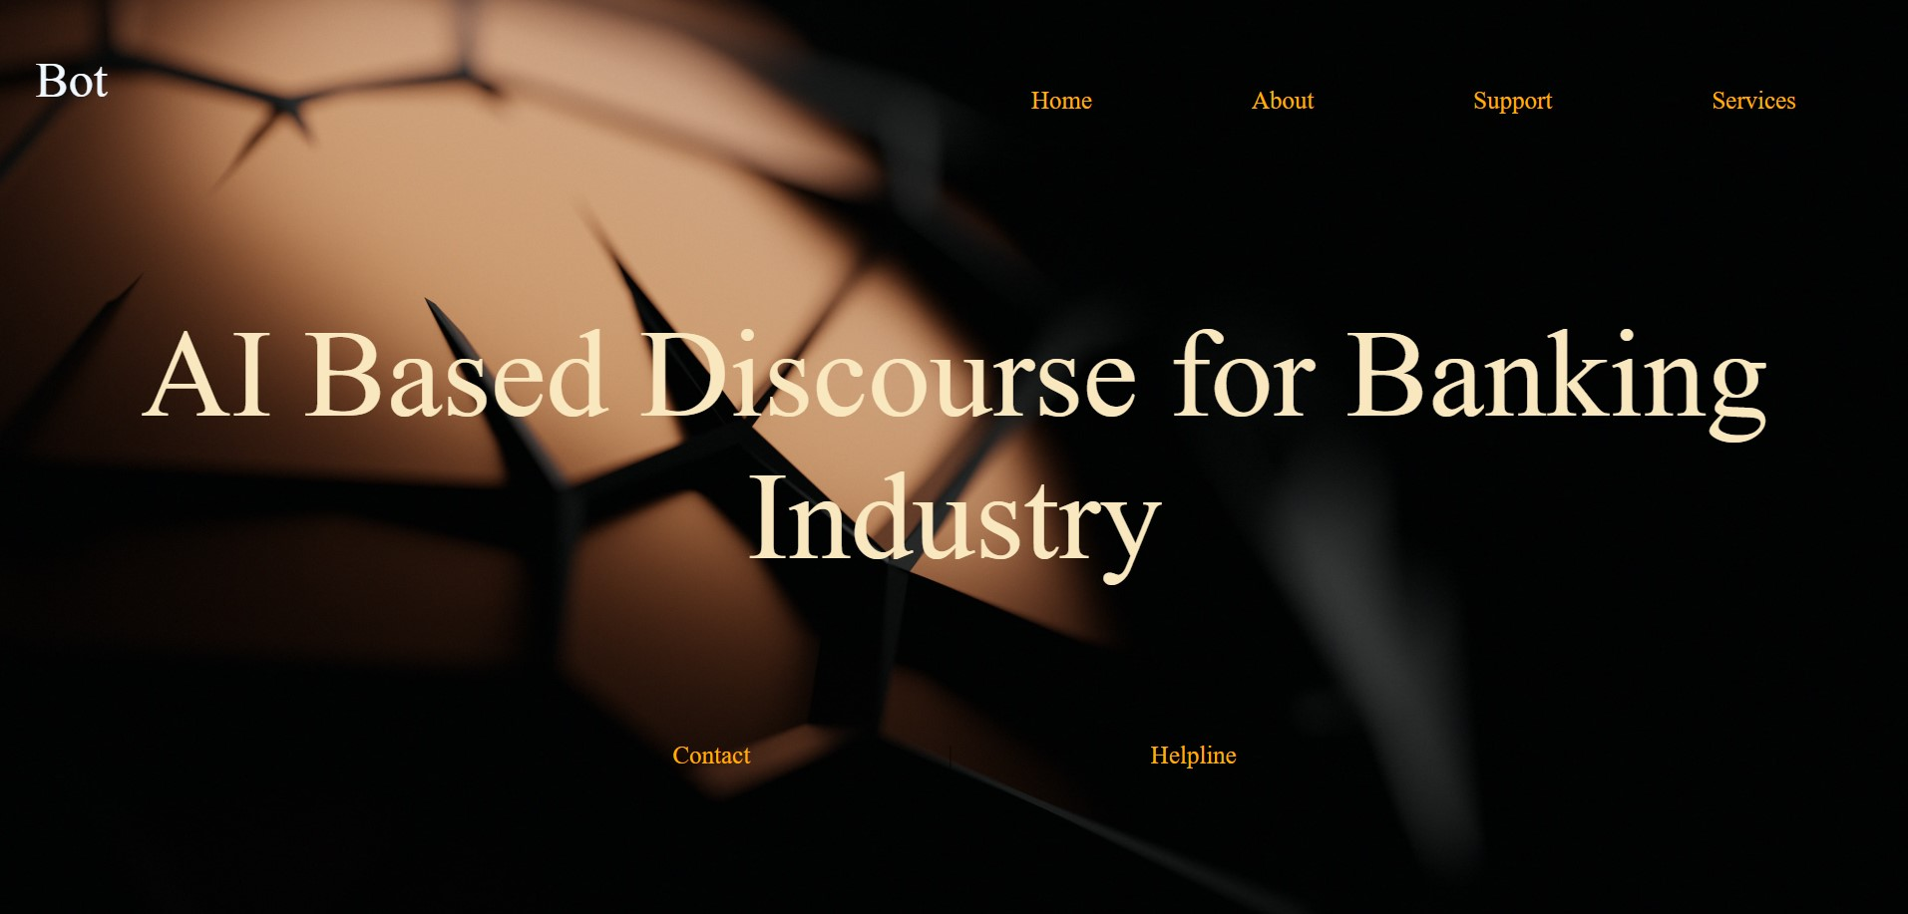
RESULT:

Slide 10
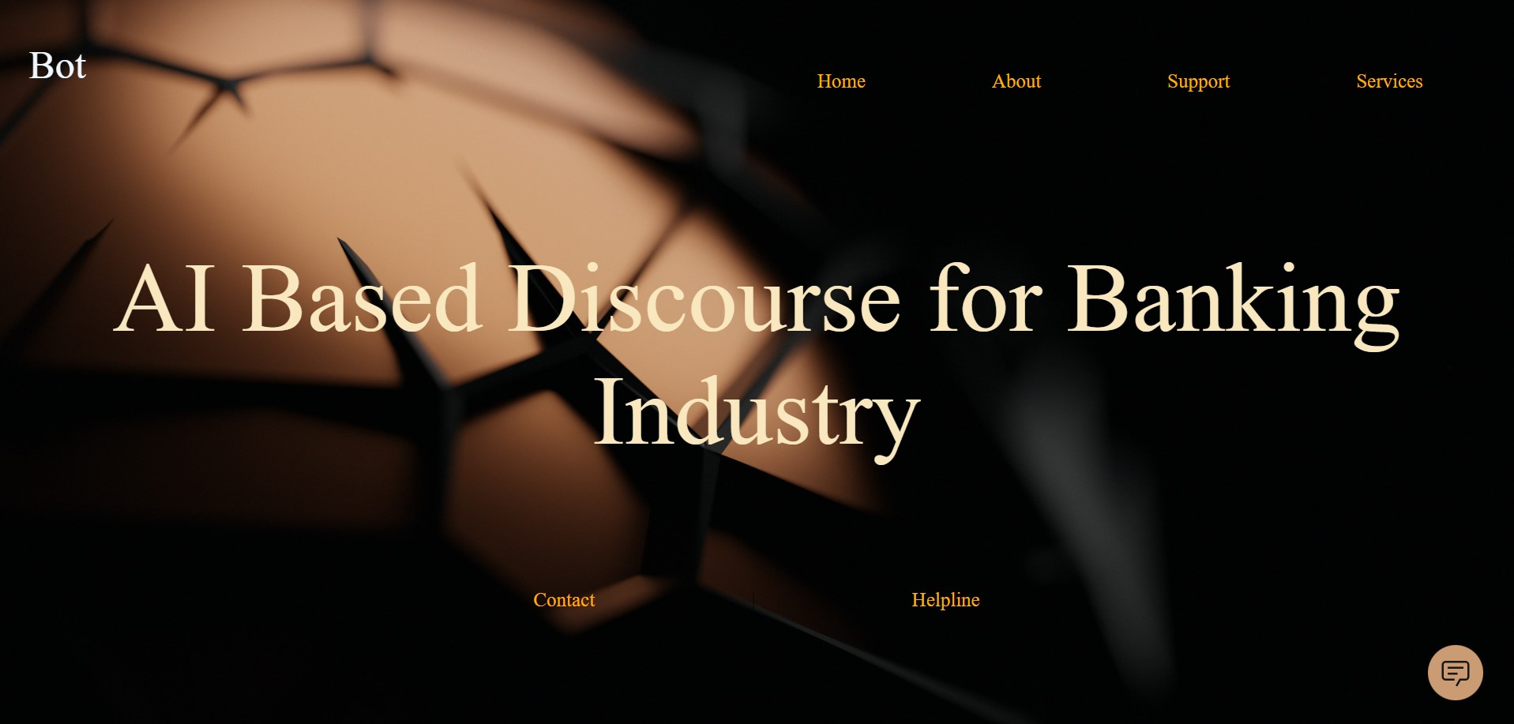

Slide 11
